Slide 1
TRVL 101:
Intro to LCC Travel
Policies & Procedures
Presented by: Kellie Ballina
LCC Business Office Fiscal and Admin. Support Specialist
Updated: 07/01/2026

Slide 2
THIS TRAINING IS ABOUT…
Understanding basic policies & procedures when preparing common types of travel docs.
  Some procedures regarding unusual circumstances can be found in the LCC Travel Procedure Guide.
  Reference the guide for more detailed info.
Explaining what valid travel related supporting docs look like.

Slide 3
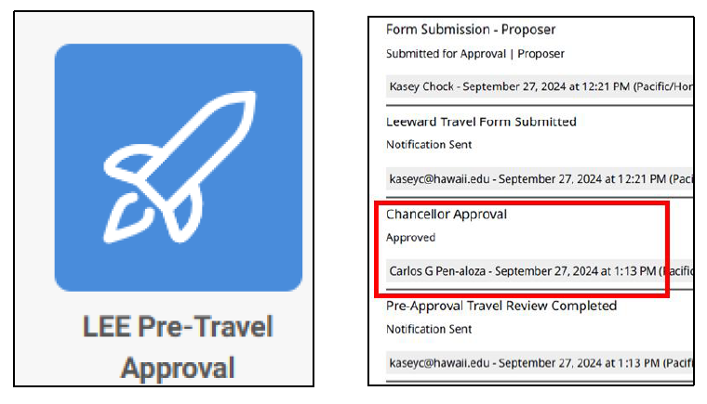
I PLAN TO TRAVEL. WHAT SHOULD I DO FIRST?
1. COMPLETE THE KUALI BUILD PRE TRAVEL APPROVAL
A. Traveler completes form online for all travels including no cost travel to obtain approvals.
No cost travel = employee travelling for official UH business but no cost to the University.
B. After completion, form routes to the supervisor, division chair, dean, Vice Chancellor and Chancellor for Academic Affairs.
Routing chain differs slightly if the traveler is not employed in an academic role
Notes:
Before any travel Doc is created, you must do the following three things:
Kuali Build Pre-Travel Approval

Slide 4
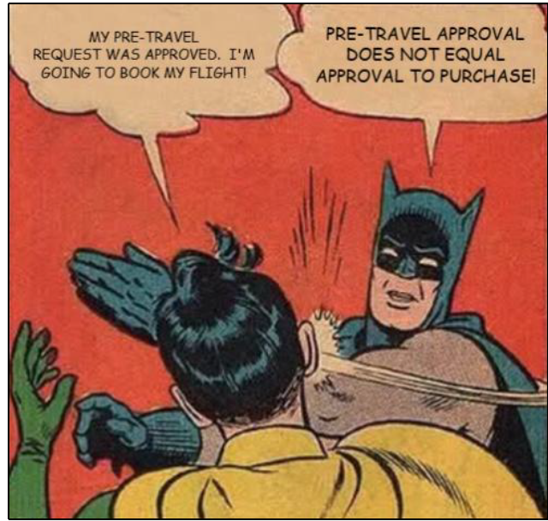
I PLAN TO TRAVEL. WHAT SHOULD I DO FIRST?
1. COMPLETE THE KUALI BUILD PRE TRAVEL APPROVAL
C. Pre-approval is only approval to travel…NOT approval to make travel related purchases.
Travelers who make purchases prior to having their travel approved by the Account Supervisor and Fiscal Administrator (F.A.) run the risk of not being reimbursed for their expense.
Notes:
Before any travel Doc is created, you must do the following three things:
Kuali Build Pre-Travel Approval

Slide 5
I PLAN TO TRAVEL. WHAT SHOULD I DO FIRST?
1. COMPLETE THE KUALI BUILD PRE TRAVEL APPROVAL
D. After Kuali Build Pre-Travel Approval is approved, Traveler or Preparer creates a new travel request.
E. Only when the eTravel Request is approved, can travel related expenses can be purchased.
https://hawaii.kualibuild.com/app/62aa95b1f62649bb05520441/run
Notes:
Before any travel Doc is created, you must do the following three things:
Kuali Build Pre-Travel Approval

Slide 6
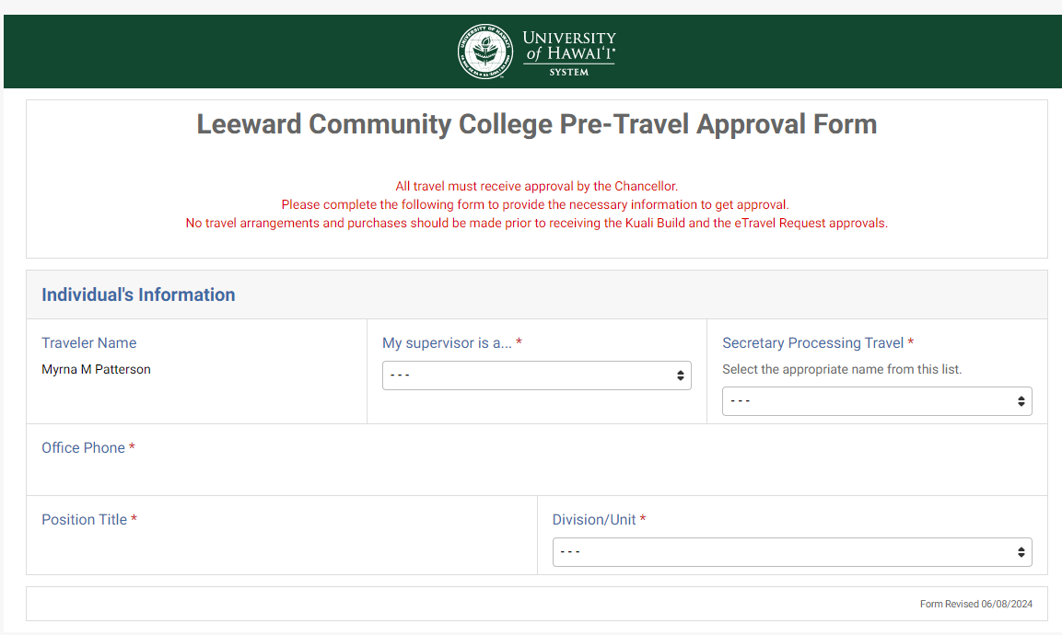

Slide 7
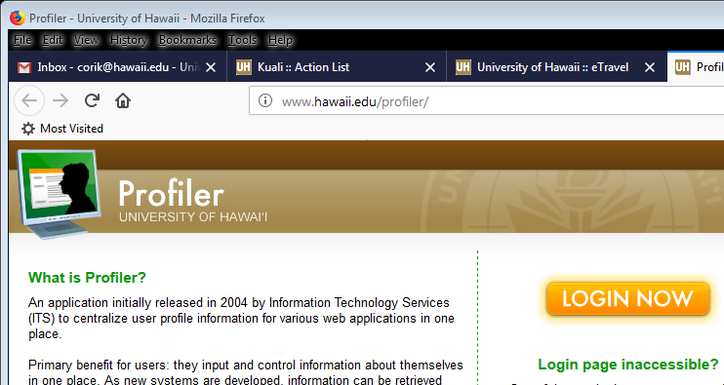
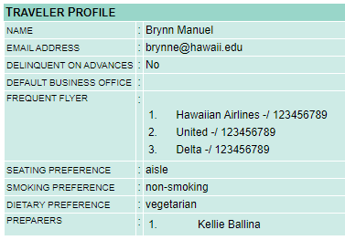
I PLAN TO TRAVEL. WHAT SHOULD I DO FIRST?
1. KUALI BUILD PRE TRAVEL APPROVAL
2. PROFILER (if you want someone else to prepare your eTravel Docs)
All employees have a profile.
To access your profile, login to: https://www.hawaii.edu/profiler/ )
Add Travel Preferences, Frequent Traveler Accounts and other information
Add preparers (Secretary or support staff) for eTravel documents
Add backup approver for eTravel approvers (Supervisors, Administrators)
Only works with eTravel, not RCUH
Notes:
Before any travel Doc is created, you must do the following three things:
2. Set up someone to prepare your Travel Docs in Profiler if you prefer

Slide 8
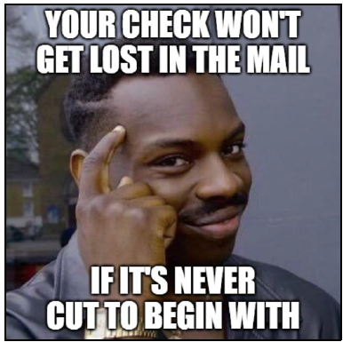
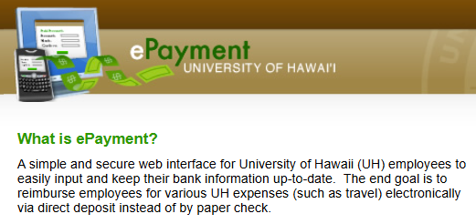
I PLAN TO TRAVEL. WHAT SHOULD I DO FIRST?
1. KUALI BUILD PRE TRAVEL APPROVAL
PROFILER
3. ePAYMENT
ePayment allows you to receive your travel reimbursements electronically.
  Also applies to Mileage DVs.
If you are seeking a Travel Advance, you are REQUIRED to be signed up for ePayment.
  Only for travel processed in eTravel
  Not valid for travel processed in RCUH
Notes:
Before any travel Doc is created, you must do the following three things:
3. Sign up for ePayment to receive your travel reimbursements via electronic payment. This step is REQUIRED if you want to obtain a Travel Advance.

Slide 9
I DID THE PRE-TRAVEL STEPS. WHAT NOW?
After the Pre-Travel steps are taken, work on your Travel Request.
  Upload supporting documents for your estimated expenses.
Upon your return, work on your Travel Completion. These must be submitted no later than 21 days from the time you return home.
  Upload receipts to substantiate your ACTUAL expenses.

Slide 10



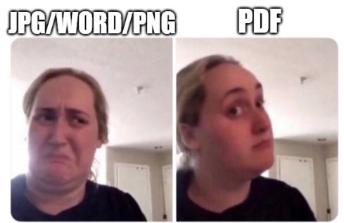

SUPPORTING DOCS THAT ARE ATTACHED TO ALL
TRAVEL REQUESTS
👎 👎 👎
👍
Disbursing sometimes has trouble opening up attachments on their end if they are not in PDF format.
Notes:
Disbursing sometimes has t.rouble opening up attachments on their end if they are not in PDF format

Slide 11
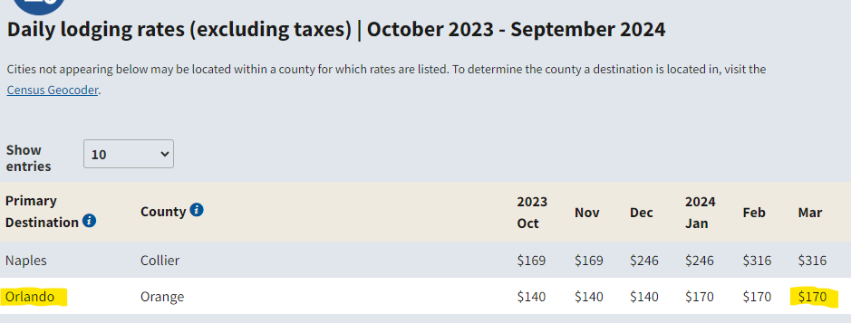
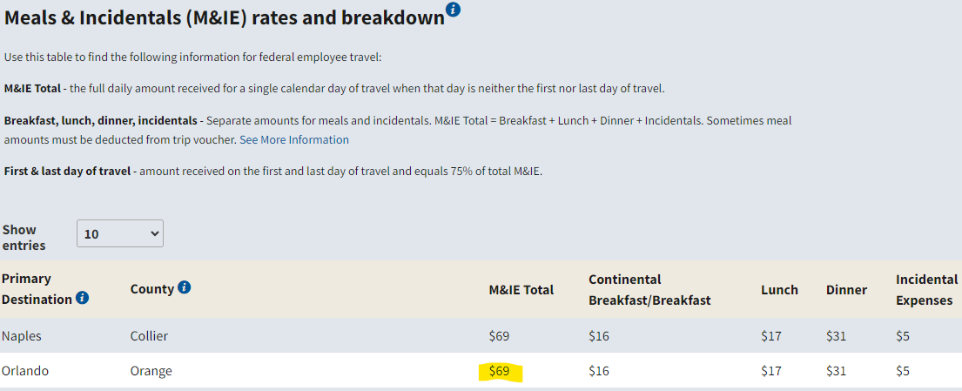
SUPPORTING DOCS THAT ARE ATTACHED TO ALL
TRAVEL REQUESTS
Federal Allowable Rate (F.A.R.) Listing
F.A.R. = allowable rates for lodging & meals, based on location.

Slide 12
SUPPORTING DOCS THAT ARE ATTACHED TO ALL
TRAVEL REQUESTS
Same-day travel
  $30 flat rate (as of July 1, 2026)

Slide 13
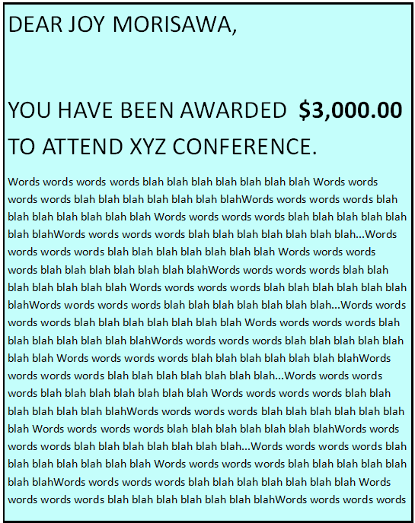
SUPPORTING DOCS THAT ARE ATTACHED TO ALL
TRAVEL REQUESTS
DEAR BILLY BOB:
If using a Travel Award:
  Copy of the award, or conference dollar amount approval letter

Slide 14
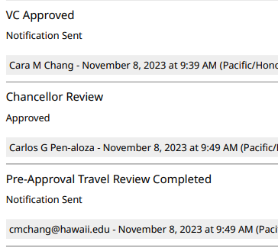
SUPPORTING DOCS THAT ARE ATTACHED TO ALL
TRAVEL REQUESTS
Approved Kuali Build Pre-Travel Approval
  Do not attach the email confirmation of approval
  Attach the actual attachment that displays the routing trail of approvals
Notes:
Disbursing sometimes has trouble opening up attachments on their end if they are not in PDF format

Slide 15
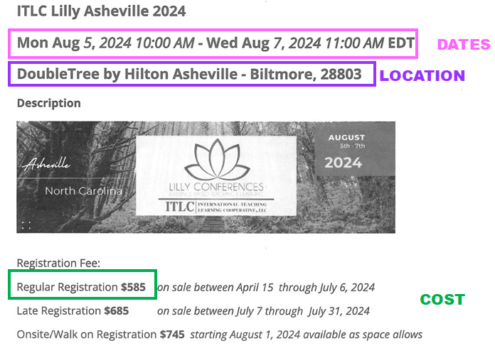
CONFERENCE: Travel Request Supporting Docs
Supporting docs will include:
  Dates
  Location
  Agenda (if available)
  Cost
Notes:
Supporting Docs include:
Dates of Conference
Location
Agenda
Cost
MEMBERSHIPS
If purchasing membership to an organization in addition to the conference registration, Form 73: Membership in Professional or Trade Organization needs to be completed and signed by the account supervisor.
Form located on the LCC Intranet
( https://intranet.leeward.hawaii.edu/busoffice )

Slide 16
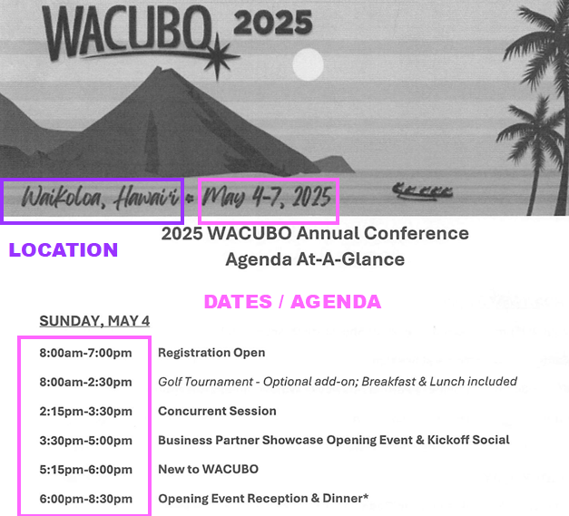
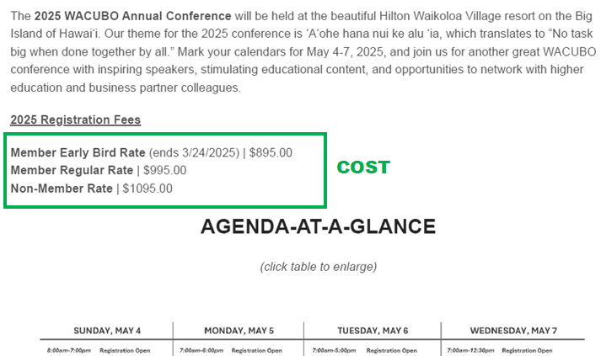
CONFERENCE: Travel Request Supporting Docs
Supporting docs include:
  Dates
  Location
  Agenda (if available)
  Cost
Notes:
Supporting Docs include:
Dates of Conference
Location
Agenda
Cost
MEMBERSHIPS
If purchasing membership to an organization in addition to the conference registration, Form 73: Membership in Professional or Trade Organization needs to be completed and signed by the account supervisor.
Form located on the LCC Intranet
( https://intranet.leeward.hawaii.edu/busoffice )

Slide 17
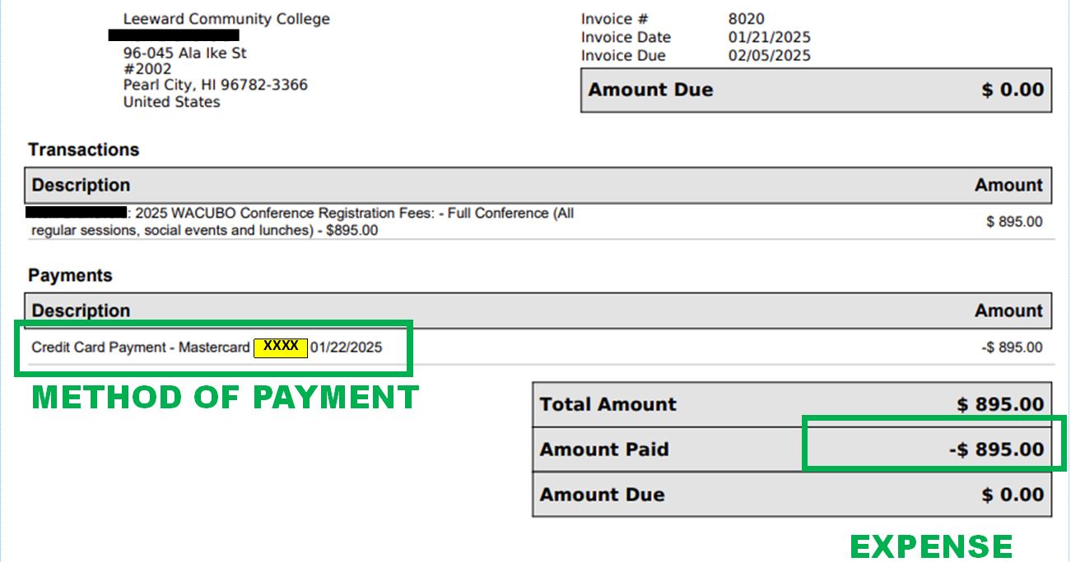
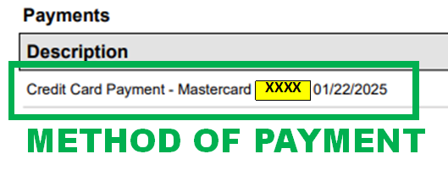
CONFERENCE: Travel Completion Supp. Docs
Supporting docs include receipts that display:
  Expense
  Method of payment
  If method of payment is not displayed, a CC statement with unrelated information redacted

Slide 18
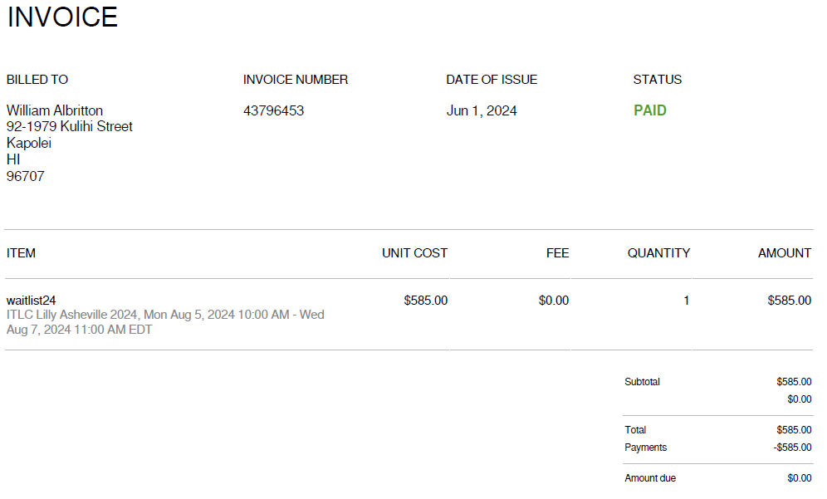
WHAT’S WRONG?
Notes:
This receipt does not display the method of payment

Slide 19
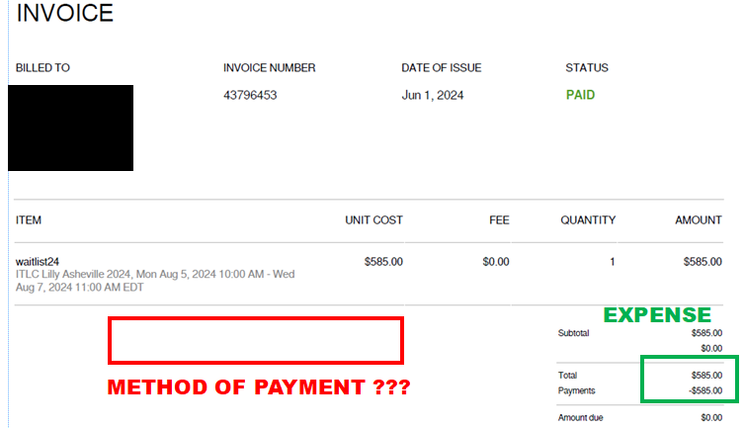
CONFERENCE: Travel Completion Supp. Docs
Receipt does not display method of payment.
Notes:
This receipt does not display the method of payment

Slide 20
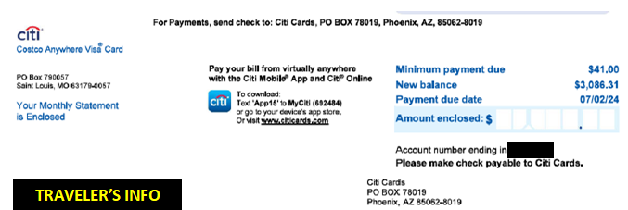
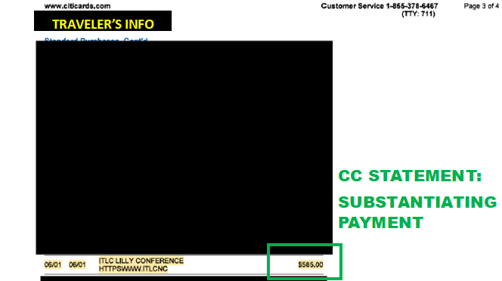
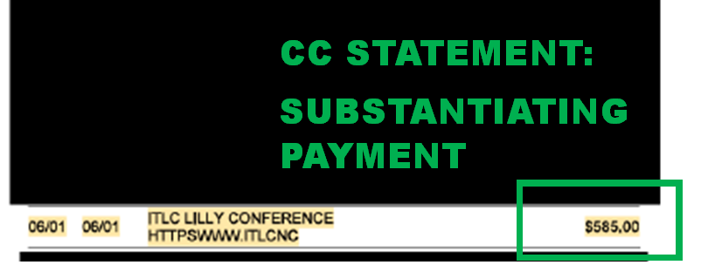
CONFERENCE: Travel Completion Supp. Docs
CC statement provided, showing the $585.00 conference purchase.
Notes:
CC statement, pretend it’s not cut up (for slideshow purposes). Traveler provides CC statement to substantiate the $585.00 purchase. All information unrelated to the purchase is redacted.

Slide 21
MEETING / SITE VISITS: Travel Request Supporting Docs
Supporting docs include:
  Agenda with dates & locations
  Costs (if applicable)
  If the purpose of business is just a meeting, and there is no official agenda, provide at least an email where the subject involves::
    coordinating travel to X destination..
    …to meet on Y day…
    …to discuss Z.

Slide 22
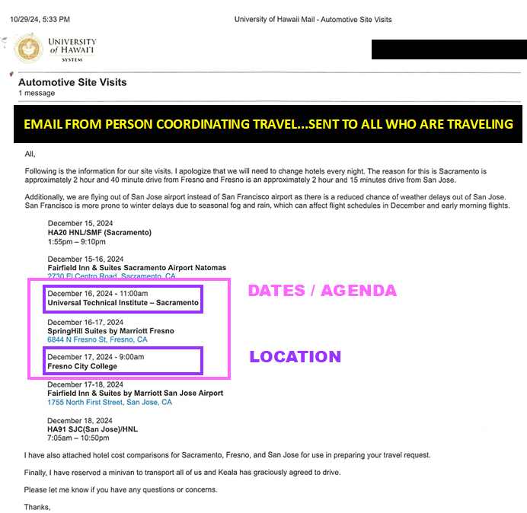
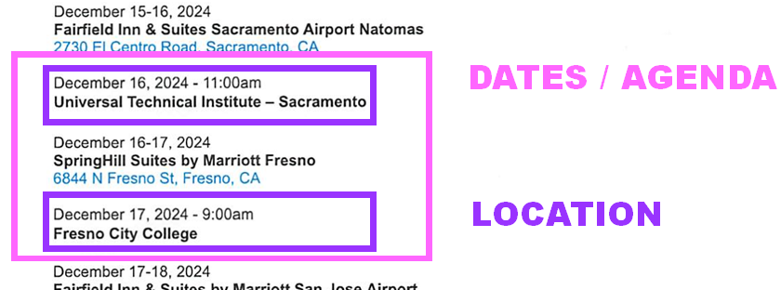
MEETING / SITE VISITS: Travel Request Supporting Docs

Slide 23
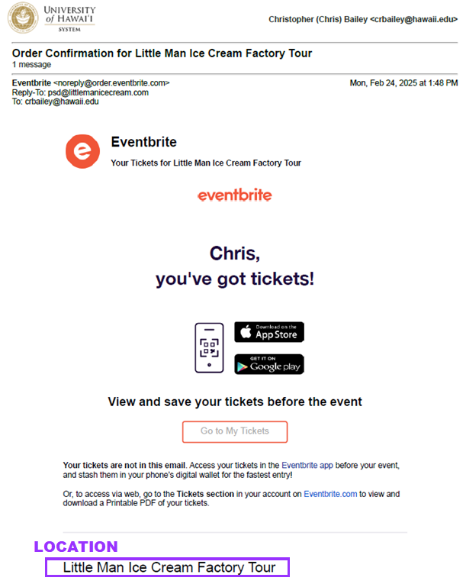
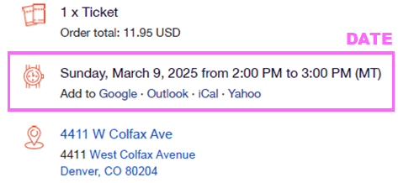
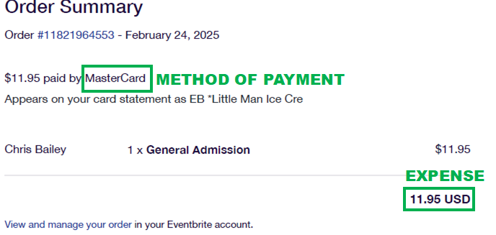
MEETING / SITE VISITS: Travel Completion Supp. Docs
Supporting docs include:
  Receipts that display method of payment
  (if applicable)
Notes:
Receipt for site visit. Pretend it’s not cut up for slideshow purposes. Receipt for Ice Cream Factory Tour displays the m

Slide 24
LODGING: Travel Request Supporting Docs
Valid hotel quotes include:
  Name of hotel
  Cost
  Dates of stay
  Occupancy
    Single…explanation required otherwise
  If all the required information is not all on the same page, multiple screenshots/printouts etc. are required.
Notes:
If selecting a hotel with a nightly rate at the F.A.R. or cheaper, only ONE quote is required.
If selecting a hotel with a rate more than the F.A.R., provide TWO quotes:
quote from preferred hotel
quote from a nearby hotel (cost comparison) to show that the preferred hotel is the more economical (cheaper) option.
The following information will be provided on the quote:
Name of hotel
Cost
Dates of stay
Occupancy (should be single…explanation required otherwise)

Slide 25
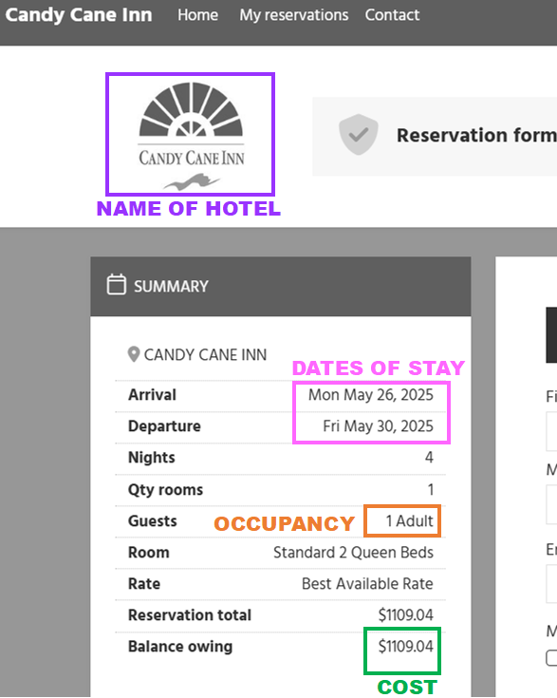
Valid hotel quotes include:
  Name of hotel
  Cost
  Dates of stay
  Occupancy

Slide 26
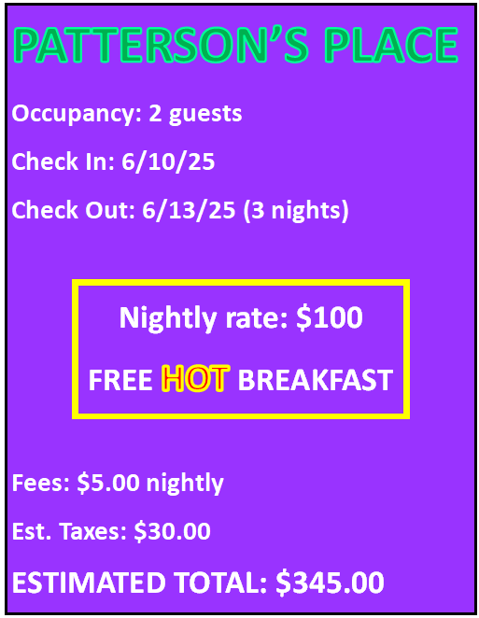
WHAT’S WRONG?
Notes:
This receipt does not display the method of payment

Slide 27
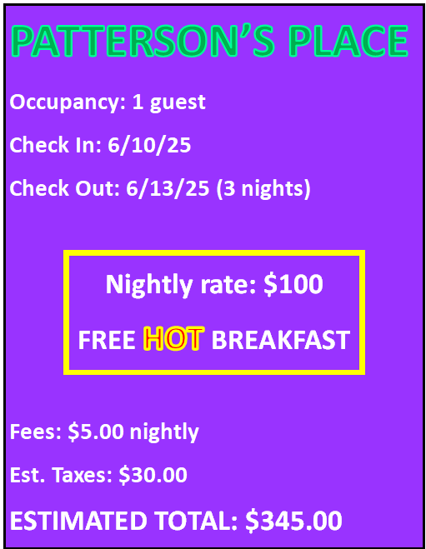
LODGING: Travel Request Supporting Docs
If a non-business traveler will be staying with you at the hotel:
  Provide additional quote for 1 guest.
  If it is more expensive for another guest to be in room, traveler will only be reimbursed up the rate of 1 guest.

Slide 28
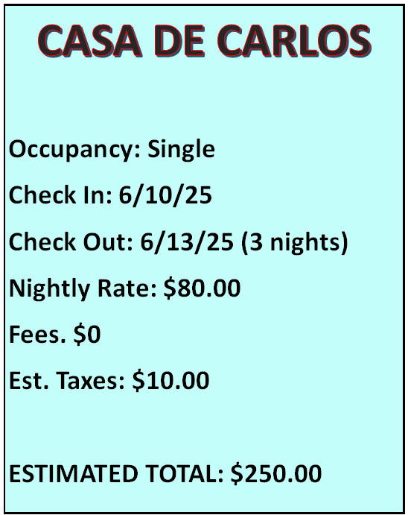
LODGING: Travel Request Supporting Docs
If preferred hotel has a nightly rate at the F.A.R. or cheaper:
  One quote required
EXAMPLE:
  F.A.R. for lodging in Las Vegas, NV = $126.00
  Nightly rate: = $80.00
  Nightly rate is lower than F.A.R.

Slide 29
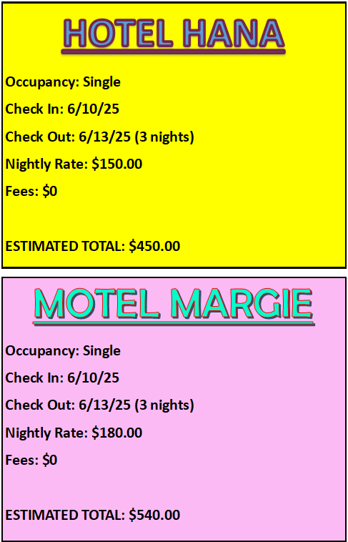
LODGING: Travel Request Supporting Docs
If preferred hotel is more than the F.A.R.
  Two quotes required
    Quote from preferred hotel
    Cost comparison quote from a nearby hotel, substantiating that the preferred hotel is cheaper.
EXAMPLE:
  F.A.R. for lodging in Las Vegas, NV = $126.00
  Nightly rate of preferred hotel: Hotel Hana
    Nightly rate: $150.00
    Nightly rate is more than F.A.R.
  Cost comparison: Motel Margie
    Nightly rate: $180.00

Slide 30
LODGING: Trav. Req. Supp. Docs: Conference Hotels
No comparison quote required
  Even if nightly rate is more than the F.A.R.
Supporting Docs:
  Documentation that the preferred hotel = conference hotel
    Usually this information is on the conference website
  Cost
  Dates of stay
  Occupancy
  For quotes taken from a conference hotel webpage::
    If it is not possible to obtain a quote displaying occupancy and exact dates, it is okay.

Slide 31
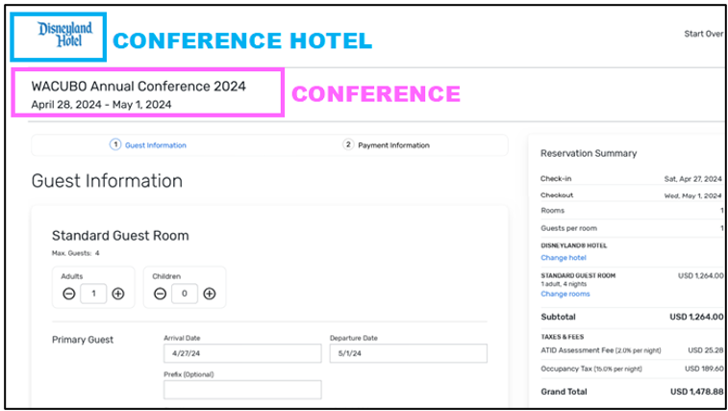

Slide 32
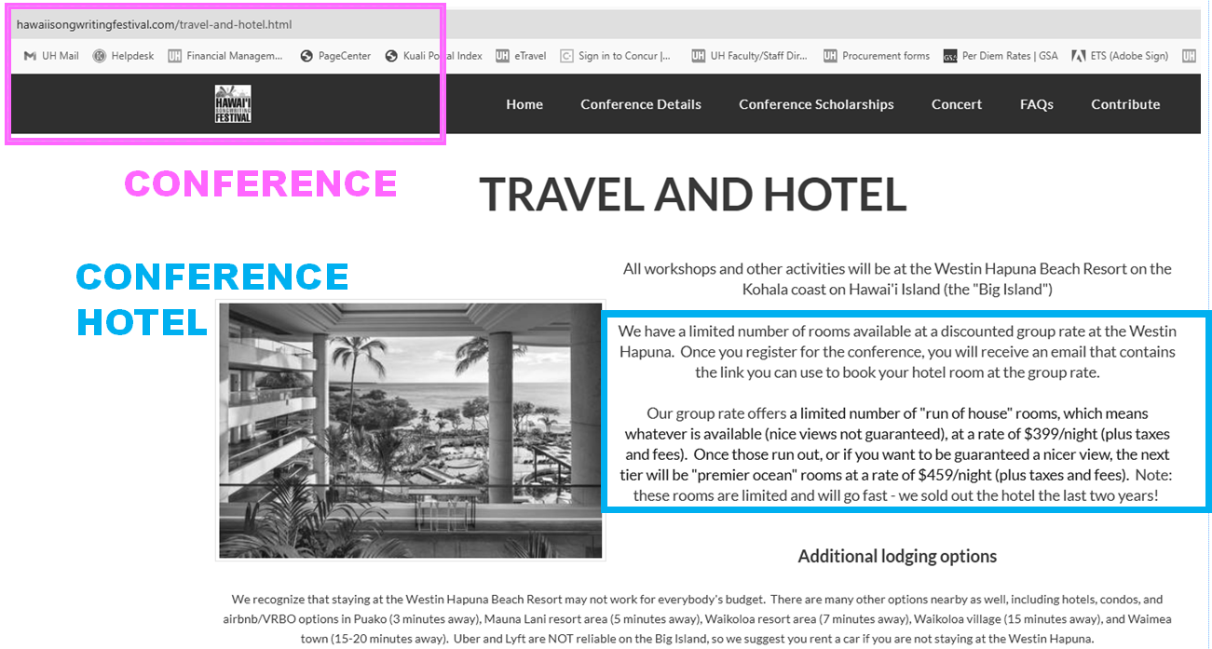
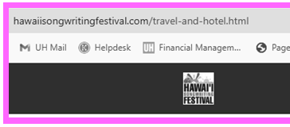
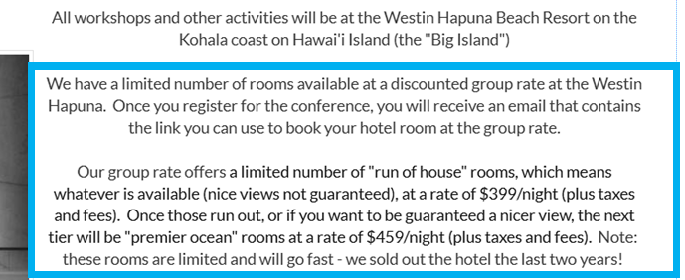

Slide 33
LODGING: Travel Completion Supp. Docs
Itemized receipts that display:
  Method of payment
  Zero balance
    Not all hotels receipts display this information.
    A CC statement showing the hotel expense will be provided as additional substantiating the payment.
Lodging expense listed in eTravel will be reduced for non-allowable expenses such as:
  Room service
  Mini Bar
  Early check-in fees (Must have business justification to be reimbursed).

Slide 34
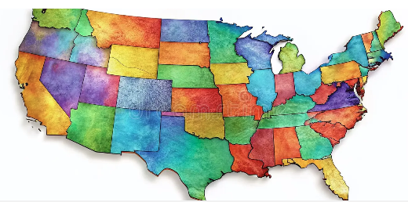
AIR: Itinerary Rules: Out-of-State Travel
Arrive at airport 3 hours prior to departure
Arrive at destination up to 24 hours before the start of events
Return flights home must depart no later than 12:00 p.m, the day after the business ends.
BUSINESS ONLY TRAVEL:
  Two quotes required:
    Preferred flight
    Cost comparison flight (more expensive)

Slide 35

AIR: Itinerary Rules: Intra-State Travel
Arrive at airport 90 minutes prior to departure
Arrive at destination on the first day of business, not before.
Return flights home must depart the same day business ends
  Exceptions made on a case-by-case basis for events that end in the evening
BUSINESS ONLY TRAVEL:
  Only ONE quote required.

Slide 36
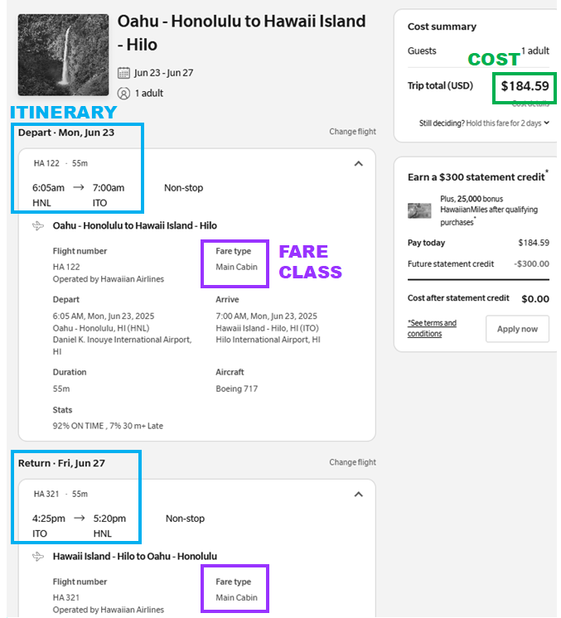
AIR: Travel Request Supporting Docs
Valid quotes include:
  Cost
  Flight itinerary, including layovers
  Fare Class
    Non-refundable only!
    Economy, Main, Standard, etc.
    Southwest: Basic (will probably change in 2026)
    Doctor’s note is required to select a higher fare class for a medical need.
Note: Pcards may not be used to pay for airfare that includes personal time.

Slide 37
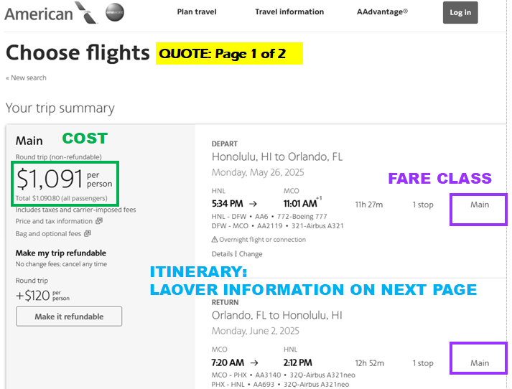
AIR: Travel Request Supporting Docs
When all the required information is not visible in one print out / screenshot, steps will be taken to ensure all required information is provided.
May result in quote being several pages long, with multiple screenshots.
Sample quote: 2 pages long.
  Page 1 of 2 displays cost and fare class.

Slide 38
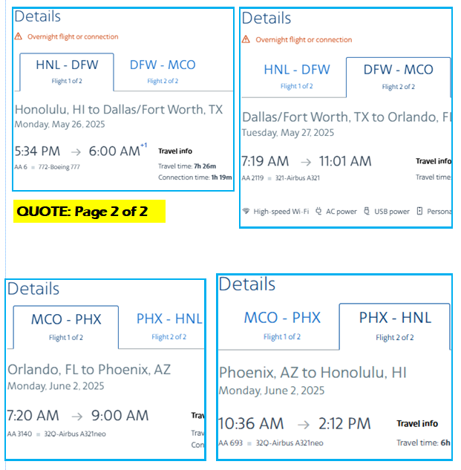
AIR: Travel Request Supporting Docs
Sample quote: 2 pages long.
  Page 2 of 2 displays itinerary.

Slide 39
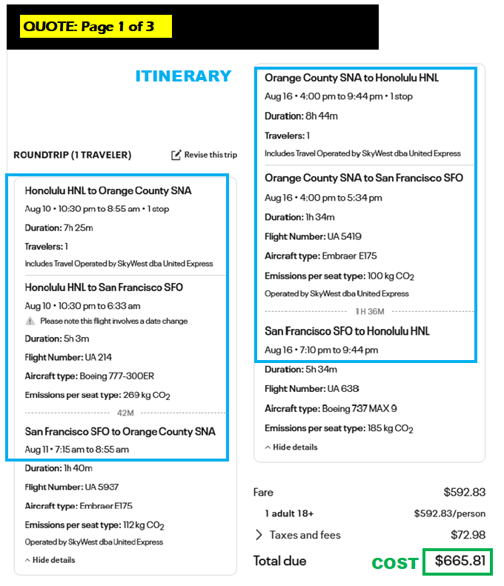
AIR: Travel Request Supporting Docs
United Air currently requires a minimum of 3 different print outs, or screenshots.
  Itinerary & Cost
  Departure Flight: Fare class
  Return Flight: Fare class
The information on fare class does not display on the same page of the itinerary.

Slide 40
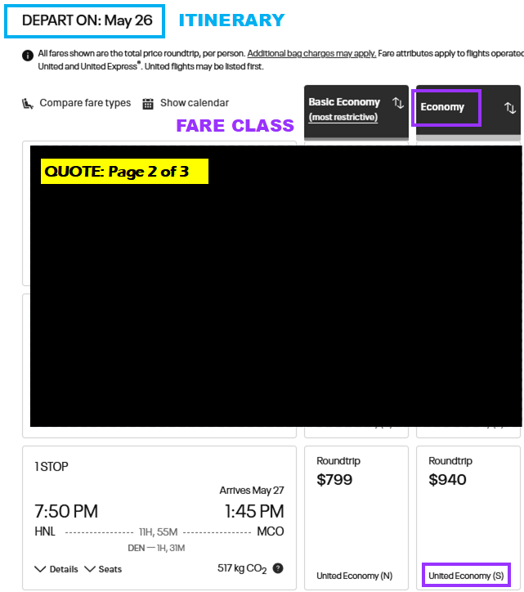
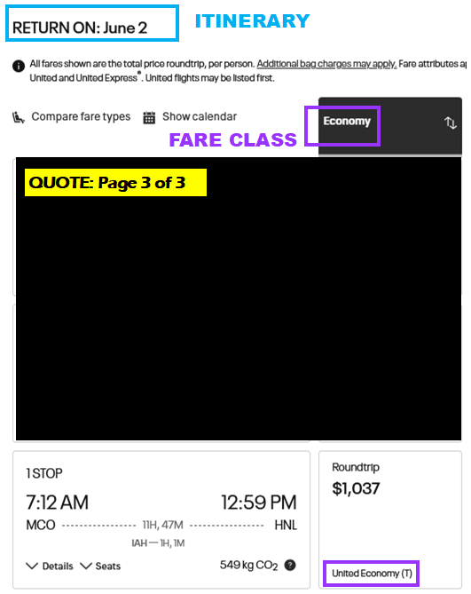
AIR: Travel Request Supporting Docs
United Air currently requires a minimum of 3 different print outs, or screenshots.
  Itinerary
  Departure Flight: Fare class
  Return Flight: Fare class

Slide 41
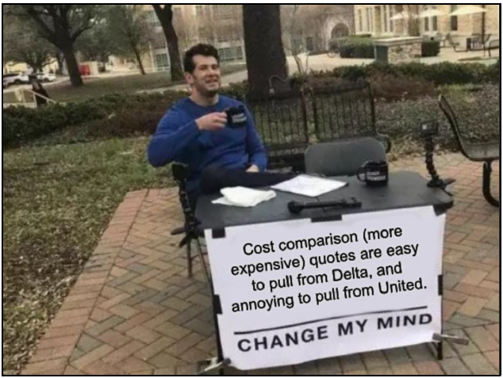
AIR: Travel Request Supporting Docs
Unless the traveler’s preferred flight is with United Air, it is not recommended to pull a comparison quote from United, since it involves extra steps.
If required information is missing, you will have to go back and pull the information anyway.

Slide 42
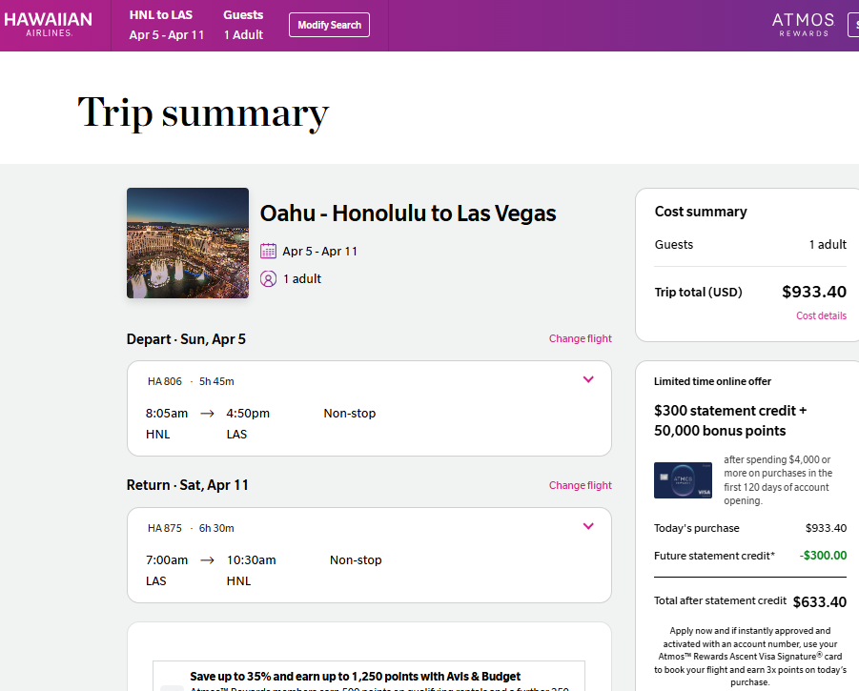
WHAT’S WRONG?
Notes:
This receipt does not display the method of payment

Slide 43
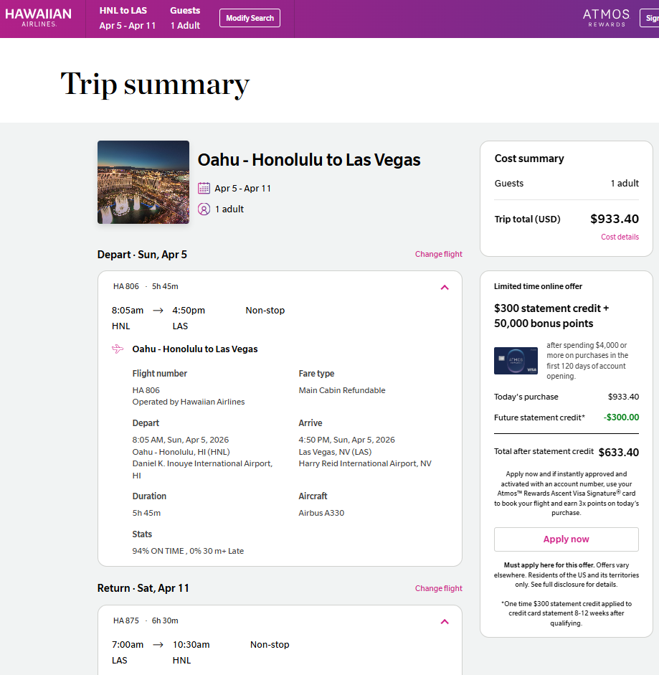
WHAT’S WRONG?
Quote was missing fare class info.
What is STILL wrong?
Notes:
This receipt does not display the method of payment

Slide 44
WHAT’S WRONG?
Refundable rates are not allowable.
Notes:
This receipt does not display the method of payment

Slide 45
AIR: Travel Completion Supp. Docs
Valid receipts display:
  Flight itinerary, including layovers
  Seat fare class
  Expense
  Method of payment

Slide 46



Third Party Websites
= type of travel agency
  Service fees not allowable expenses
  Personal choice to book through third party rather than directly from hotel or airline
  Can be difficult or impossible to obtain itemized receipt for lodging (requirement).
    Traveler pays third party
    Third party pays hotel
    Third party charges what they want and hotels don’t always know the breakdown of the charges.
ACTUAL Hotel Website
ACTUAL Airline Website

Slide 47
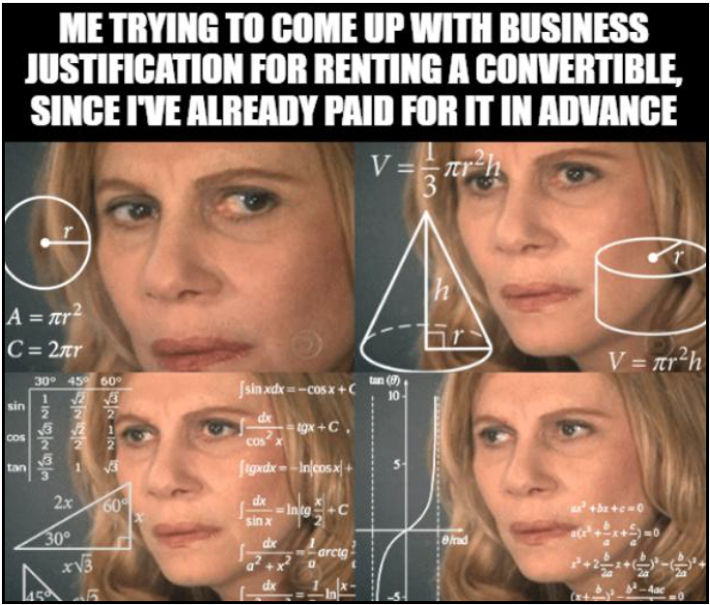
CAR RENTAL: Rules
Not allowed when staying at the conference hotel.
Allowable classes of vehicles:
  Economy
  Compact
  Justification required to rent a larger vehicle
Insurance & Optional Services
  Intra-State: Decline all insurance options
  Out-of-State: ONLY Collision Damage Waiver permitted.

Slide 48

CAR RENTAL: Rules
Turo and other services where you are renting directly from the owner of the vehicle, are NOT allowable.

Slide 49
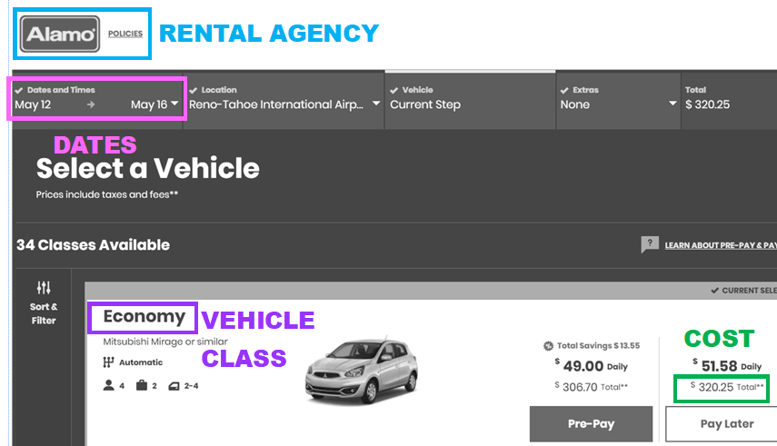
CAR RENTAL: Travel Request Supporting Docs
Two quotes
  Quote from preferred agency
  Cost comparison quote (more expensive)
Quotes must display:
  Rental agency
  Dates
  Vehicle Class
  Cost

Slide 50
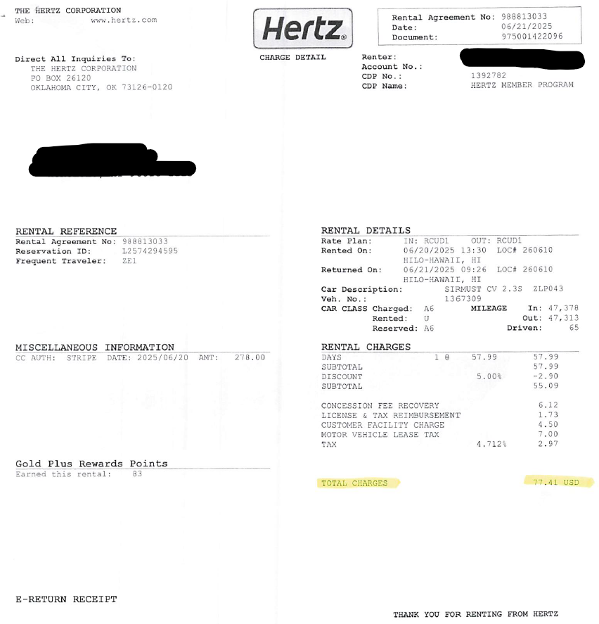
CAR RENTAL: Travel Completion Supp. Docs
Receipt that display:
  Method of payment
  Zero balance
  If the rental agency does not provide receipts that display the required information, a CC statement substantiating the purchase will be provided.
    Unrelated information will be redacted.
    Some receipts do not display $0 balance.

Slide 51
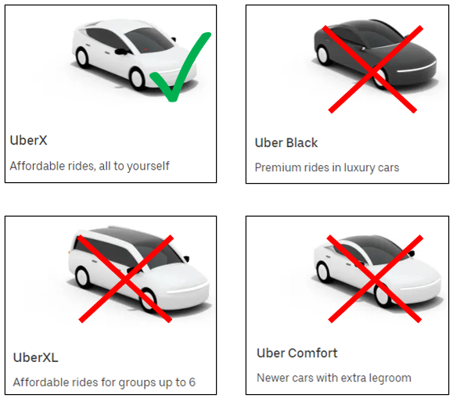
RIDESHARES: Rules
Select basic versions of rideshares.
  Uber X
  Basic Lyft
You may not make purchases with funds that are sitting in your account.
  Funds may include credits, gifts, etc.
  Travelers may not “pocket” a reimbursement.

Slide 52

RIDESHARES: Travel Completion Supp. Docs
Receipts that display method of payment.
  If your rideshare is known to display additional information on their receipts, that is also required to be present:
    Maps
    Start & end destinations
    Fare Class

Slide 53


RIDESHARES: Travel Completion Supp. Docs
If Money Transfer Apps (Venmo, PayPal, etc.) were used to pay for a ride, those receipts are required, in addition to the ride receipt.

Slide 54

RIDESHARES: Travel Completion Supp. Docs
Expense amount listed in eTravel should not include the following charges, which come out of Incidentals (IE in M&IE)
  Wait time fees
  Reservation fees
  Tip

Slide 55

RIDESHARES: Travel Completion Supp. Docs
Expense amount listed in eTravel does not include the following charges, which come out of Incidentals (IE in M&IE)
  Wait time fees
  Reservation fees
  Tip

Slide 56

WHAT’S WRONG?

Slide 57

WHAT’S WRONG?

Slide 58


Slide 59

WHAT’S WRONG?

Slide 60

WHAT’S WRONG?
Expense amount listed in eTravel should not include the following charges, which come out of Incidentals (IE in M&IE)
  Wait time fees
  Reservation fees
  Tip
UBER: Booking Fees and Reservation Fees are two different fees.
  Booking = reimbursable
  Reservation = reimbursed through Incidentals

Slide 61

TRAVEL ADVANCES: Traveler Eligibility
  Signed up for ePayment.
  No outstanding Travel Completions associated with a Travel Advance, more than 30 days after the return date of a previous trip.

Slide 62

TRAVEL ADVANCES: Eligible Expenses
  Airfare (with receipt)
  Lodging (with booking confirmation)
    Up to F.A.R.
    Balance paid out upon submittal of Travel Completion
    EXAMPLE: F.A.R. for Mobile, Alabama = $114
    Nightly rate with fees = $120
    Upon approval of the Travel Advance, you will receive $114.00 per night
    $114 x 3 nights = $342.00 Total Lodging Advance
  Conference fees (with receipt)

Slide 63

TRAVEL ADVANCES: Procedure (eTravel)
  *Travel Advances processed in RCUH follow a different procedure. Refer to RCUH Procedure Guide.
  Complete a Travel Request + Advance.
  Attach QUOTES for estimated expenses. Do not make any purchases until your request is approved by the F.A.
  Submit Doc for approvals. Upon approval of the Travel Request, F.A. will DENY the Travel Doc. The act of denying the doc sends it back to the person who created it, so they can revise it.
  F.A. will include a message saying that the document has actually been approved, and to make purchases.
  (Approval by denial)

Slide 64

TRAVEL ADVANCES: Procedure (eTravel)
  5. Make travel arrangements.
  6. Attach receipts/confirmation of payment emails / hotel booking confirmations to the Doc, for expenses you are seeking advance payment for.
  7. Resubmit the Doc for a SECOND ROUND of approvals.
  8. Traveler will receive an automated email when the F.A. has officially approved their Travel Request a second time.
  …
  Due to the functionality of the RCUH Platform, the process of having RCUH Travel Advances approved differs from eTravel.

Slide 65
TRAVEL ADVANCES: Procedure (eTravel only)
Submit Travel Advance for round 1 of approvals no later than 6 weeks prior to departure date.
Travel Advances often get held up on the Content Review Approval level
  Discrepancies
  Additional documentation required
Travel Advances require two rounds of approvals.
Doc routes to Disbursing after approved by the F.A. It must reach them a minimum of 10 business days prior to the departure date.

Slide 66


When justification or further explanation about a purchase is required, statements can be input in the eTravel Comments box, in the bottom left corner of the Doc.

Slide 67

Something to note…
Only Traveler notified when the Travel Doc has been officially approved at the F.A. level.
Preparers: If preparing Travel Requests WITHOUT Advance, tell traveler to inform you when Travel Doc has been approved, if you are making their travel arrangements.
eTravel: Document Route Log:
  Travel approved at Fiscal Authority Level = Approved Travel Doc.

Slide 68

RCUH
Use RCUH to prepare employee Travel Docs if travel is funded by…
  Some grants/Trust Funds: Acc. starts with 4XXXXXX
  Perkins Funds: Acc. starts with 5XXXXXX
  Federal Contracts & Grants: Acc. starts with 6XXXXXX
RCUH is not as user friendly as eTravel.
Refer to RCUH Travel Guide for more info.

Slide 69


UH Foundation
Use eTravel to allow for Business Office review, and to prepare the supporting doc UH Foundation requires.
Travel reimbursements are processed via Concur.
Obtain access to Concur via UH Foundation website.
More detailed info in Procedure Guide.

Slide 70

Non UH Employees
Refer to procedure guide for info on processing travel.
Method differs depending on traveler type, payment type, funding source, etc…

Slide 71


Students, Student Employees, & State Employees: DISB-4

Slide 72
Questions & Comments?

